Slide 1

DEPARTMENT OF COMPUTER SCIENCE & ENGINEERING(DATA SCIENCE)
“AI BASED SMART HEALTHCARE SYSTEM FOR OPTIMIZED AMBULANCE ROUTING AND PREDICTIVE ICU BED AVAILABILITY ”
COURSE NAME : Project Phase – I
COURSE CODE:22CDS65
Presentation by,
NAME :Sreejith S, Manoj P, P Harshad Ali Khan, Poornima
USN: 1NH22CD127,1NH22CD064,1NH22CD0771NH22CD081
Under the Guidance of ,
Guide Name:Ms. Shwetha
Designation: Associate professor , CSE(DS)

Slide 2
Agenda
Introduction
Problem statement
Objectives
Requirements and design
Scope
Limitations of the existing system
Design modules
Literature survey/Related Work
Societal benefits
References

Slide 3
Introduction
In modern healthcare, time is a critical factor in saving lives, especially during medical emergencies.
Existing systems lack the ability to make real-time decisions due to outdated routing mechanisms and manual ICU coordination.
Urban congestion and ICU bed shortages are persistent issues that delay treatment and increase fatality risks.
This project aims to leverage Artificial Intelligence to improve two major factors in emergency care:
Ambulance routing with the fastest and most efficient path.
Predictive analysis to determine ICU bed availability even before the ambulance reaches the hospital.

Slide 4
Problem Statement
Emergency services currently operate on static dispatching protocols and cannot adapt dynamically to traffic or hospital loads.
There is no predictive mechanism in place to forecast ICU occupancy or future availability based on trends.
Existing systems are often fragmented; ambulance routing, hospital management, and patient triaging work independently with minimal communication.
This leads to:
Increased patient transit time
Overloaded hospitals receiving new emergency cases
Patients being referred or rerouted mid-transit
The project addresses this fragmentation by proposing a unified intelligent platform for real-time decision-making.

Slide 5
Objective
To Optimize Emergency Ambulance Routing Using Real-Time GIS and AI Clustering Algorithms
To Predict ICU Bed Availability Using Historical and Real-Time Hospital Data
To Enable a Centralized, Scalable Decision-Support Dashboard for Real-Time Monitoring and Resource Allocation

Slide 6
Requirements and Design
Technologies Used:
Python (ML models)
GIS APIs (Google Maps/Folium)
Real-time traffic data (OpenStreetMap/Map box)
Frontend: Stream lit or Flask
Backend: SQLite or Firebase
Design Components:
Ambulance Routing Module
Uses clustering + real-time traffic
ICU Bed Prediction Module
Time-series + hospital load trends
Dashboard Interface
Interactive visualization for hospitals and operators

Slide 7
Scope
The system is particularly relevant for metropolitan areas where population density and traffic cause delays in healthcare response.
It can be integrated into:
Emergency medical services (EMS)
Private hospital chains
Government-run healthcare networks
It provides a modular structure where hospitals can plug into the system for ICU tracking and ambulance dispatch.
Can be expanded to include:
Non-emergency patient transportation
Blood delivery routing
Mobile ICU vans

Slide 8
Limitation of the existing system
Reactive vs Proactive: Current systems respond to events but do not forecast or anticipate ICU shortages or traffic surges.
Manual ICU tracking: No automation in bed availability—requires human intervention, which is prone to delays and inaccuracies.
No integration of ambulance data with hospital infrastructure—results in poor coordination.
Non-adaptive routing: Ambulances follow the shortest path without accounting for real-time congestion, construction zones, or priority lanes.
Data silos: Patient data, route info, and ICU stats are stored in separate systems that don’t talk to each other.

Slide 9
Literature Survey/Related Work
A comprehensive review of recent research was conducted to analyze existing smart healthcare systems, particularly those focused on ambulance routing and ICU resource management. The following works were identified as foundational to our proposed system:
1.Smart Amb: An Integrated Platform for Ambulance Routing and Patient Monitoring
Authors: Ashmawy et al. | IEEE (2019)
Contribution: Combines GPS-enabled ambulance tracking with real-time patient vitals monitoring.
Limitation: Lacks predictive analytics for ICU beds and dynamic traffic-based route optimization.
Relevance: Inspires our idea to integrate both monitoring and routing features.

Slide 10
Literature Survey/Related Work
2. A Novel Smart Ambulance System – Algorithm Design and Performance Analysis
Authors: Selim et al. | IEEE (2022)
Contribution: Introduces algorithm-based decision-making to improve ambulance response.
Limitation: Static route planning; not adaptive to changing traffic or ICU load.
Relevance: Highlights the importance of dynamic route optimization.
3. ACA-R3: Edge-AI Autonomous Ambulance-Route Resource Protocol
Authors: Ahmed et al. | IEEE IoT Journal (2023)
Contribution: Uses edge computing to decentralize routing decisions and improve latency.
Limitation: Focused more on networking architecture than ICU prediction.
Relevance: Influences our system architecture with low-latency decision modules.
4. A Smart Ambulance with Decision-Making Process for Rescue Efficiency
Author: Thai jiam | IEEE (2022)
Contribution: Integrates multiple data sources (traffic, patient condition) for rescue decisions.
Limitation: No machine learning models for hospital load forecasting.
Relevance: Validates multi-source data integration approach.

Slide 11
Literature Survey/Related Work
5. Data-Based Optimization of Intra-Hospital Patient Transport
Authors: Kropp et al. | Springer (2024)
Contribution: Applies AI to plan hospital-internal patient logistics and transport.
Limitation: Does not extend to pre-hospital (ambulance) logistics.
Relevance: Supports our ICU availability forecasting model.
6. A Data-Driven Framework for Routing Mobile Medical Facilities
Authors: Yücel et al. | Annals of OR (2020)
Contribution: Optimization algorithms for dynamic routing of healthcare vehicles.
Limitation: Geared towards rural/remote deployment; lacks urban traffic integration.
Relevance: Informs routing algorithm selection (e.g., K-means + A*).

Slide 12
Literature Survey/Related Work
7. Smart Ambulance Management with Real-Time Monitoring
Authors: Nithyashree et al. | IEEE (2023)
Contribution: Introduces patient vitals monitoring in-transit with hospital communication.
Limitation: Ignores traffic conditions and hospital ICU prediction.
Relevance: Reinforces our dashboard and real-time data idea
8. Smart Ambulance System for Emergency-Route Highlighting
Author: Kar kar | IEEE (2019)
Contribution: Highlights emergency paths using IoT-based visual indicators.
Limitation: Hardware-focused; lacks predictive or ML components.
Relevance: Motivates route visualization with folium/GIS integration.

Slide 13
Literature Survey/Related Work
While several papers propose intelligent ambulance or patient monitoring systems, none integrate both predictive ICU management and real-time routing in one platform.
Key limitations across the literature include:
Lack of predictive models
Inability to adapt routes mid-transit
Poor communication between ambulance and hospital
Our approach closes these gaps through:
ML-based ICU forecasting Using Long Short-Term Memory (LSTM) Neural Networks
Dynamic routing using live GIS data Dijkstra’s Algorithm + Real-time Traffic Weighting via A* or Reinforcement Learning (RL)
Unified real-time decision dashboard

Slide 14
Societal Benefits
Saves lives by minimizing time-to-treatment during critical emergencies.
Reduces the burden on emergency rooms by distributing patients based on predicted ICU load.
Provides rural and urban parity by enabling scalable smart healthcare solutions in less equipped areas.
Promotes transparency and accountability by offering traceable and data-backed decisions.
Improves public trust in emergency services, encouraging citizens to rely more on them during crises.

Slide 15
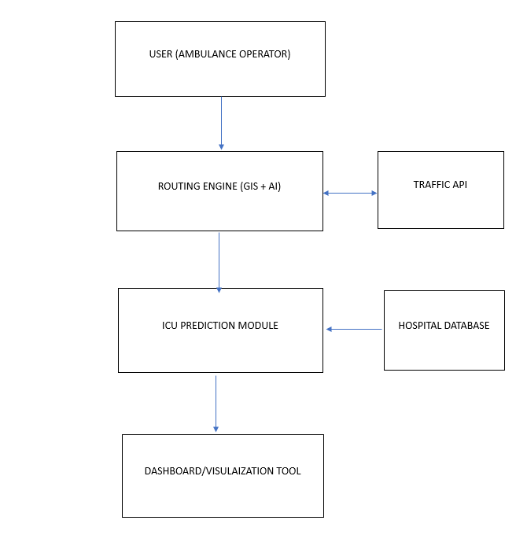
Flow diagram

Slide 16
References
Kropp, Tobias, Yuhao Gao, and Kunibert Lennerts. "Data-based optimisation of intra-hospital patient transport capacity planning." OR Spectrum (2024): 1-54.
Ashmawy, Mohamed N., Ahmad M. Khairy, Mohamed W. Hamdy, Anas El-Shazly, Karim El-Rashidy, Mohamed Salah, Ziad Mansour, and Ahmed Khattab. "SmartAmb: An integrated platform for ambulance routing and patient monitoring." In 2019 31st International Conference on Microelectronics (ICM), pp. 330-333. IEEE, 2019.
SELIEM, HAFEZ, TAREK RAHIL SHELTAMI, and TURKI M. ALGHAMDI. "A Novel Smart Ambulance System—Algorithm Design, Modeling, and Performance Analysis."
Ahmed, Syed Thouheed, Syed Muzamil Basha, Manikandan Ramachandran, Mahmoud Daneshmand, and Amir H. Gandomi. "An edge-AI-enabled autonomous connected ambulance-route resource recommendation protocol (ACA-R3) for eHealth in smart cities." IEEE Internet of Things Journal 10, no. 13 (2023): 11497-11506.

Slide 17
5. Thaijiam, Chanchai. "A smart ambulance with information system and decision-making process for enhancing rescue efficiency." IEEE Internet of Things Journal 10, no. 8 (2022): 7293-7302.
6. Yücel, Eda, F. Sibel Salman, Burçin Bozkaya, and Cemre Gökalp. "A data-driven optimization framework for routing mobile medical facilities." Annals of Operations Research 291 (2020): 1077-1102.
7. Nithyashree, M., Krupa P. Nadgir, N. Pavithra, and R. Sindhu Rajendran. "Smart Ambulance Management System with Real-Time Patient Monitoring." In 2023 International Conference on Network, Multimedia and Information Technology (NMITCON), pp. 1-6. IEEE, 2023.
8. Karkar, AbdelGhani. "Smart ambulance system for highlighting emergency-routes." In 2019 Third World Conference on Smart Trends in Systems Security and Sustainablity (WorldS4), pp. 255-259. IEEE, 2019.

Slide 18
Thank you
Queries ?

